Slide 1


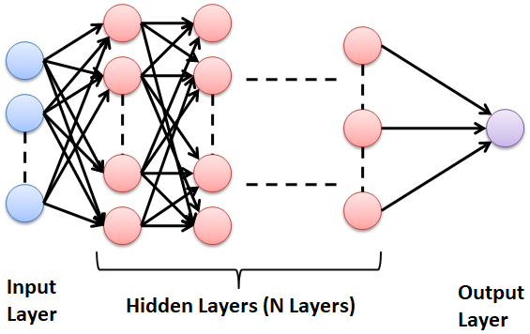
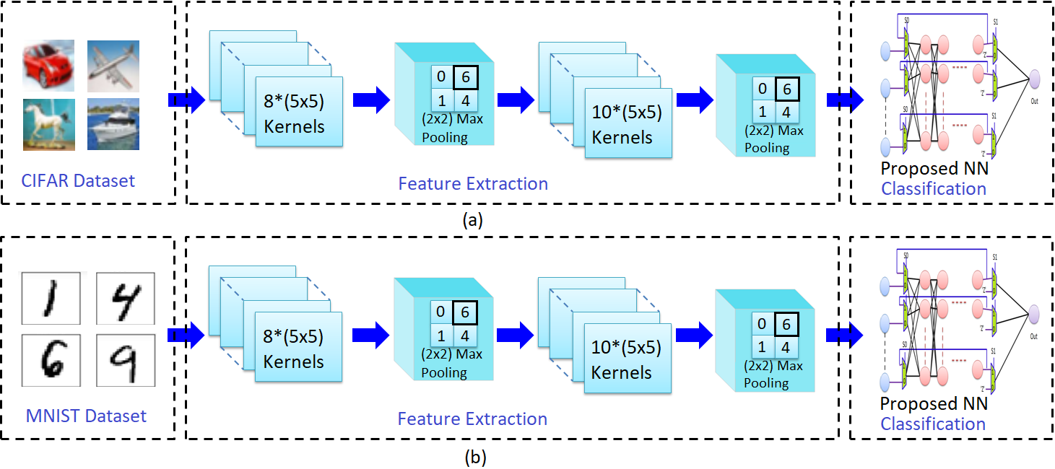
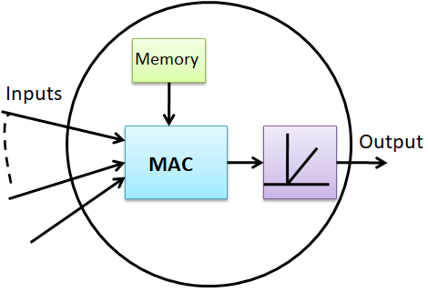
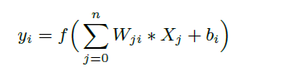
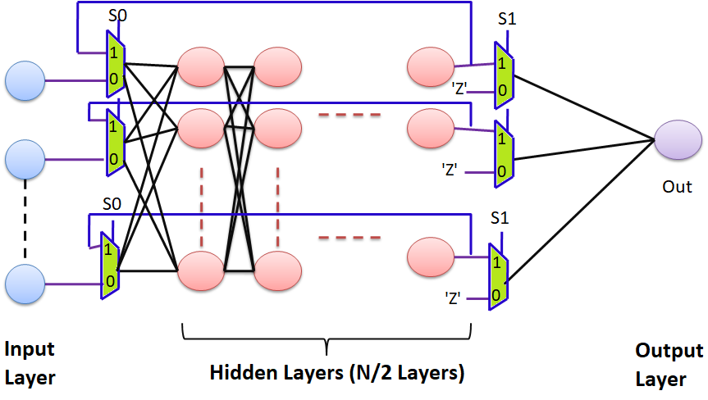
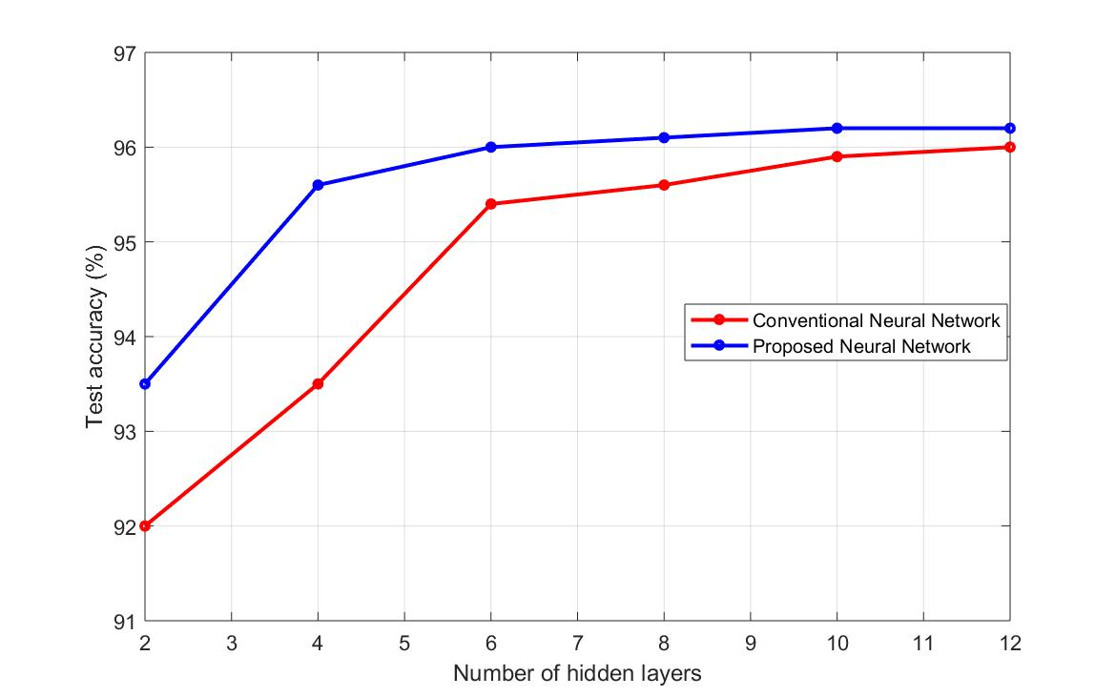
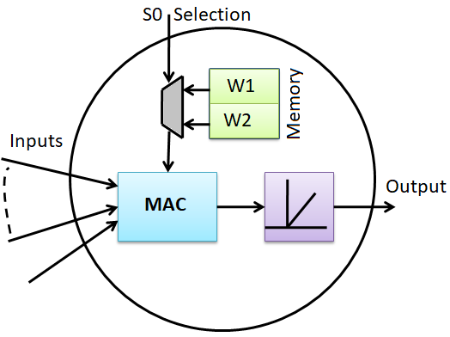
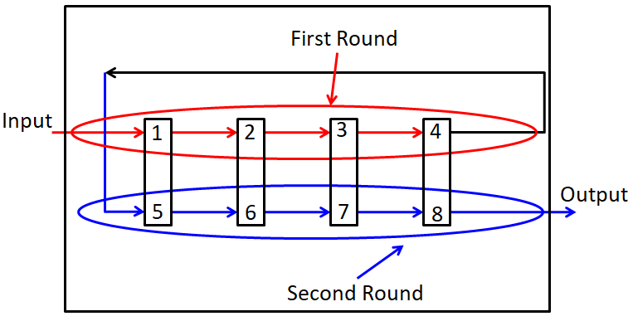
An Efficient Approach for Neural Network Architecture
Kasem Khalil, Omar Eldash, Ashok Kumar, and Magdy Bayoumi
The Center for Advanced Computer Studies (CACS), University of Louisiana at Lafayette
{kmk8148, oke1206, axk1769, mab0778}@louisiana.edu
Abstract
—Neural network is one of the main concepts used in machine learning applications. The hardware realization of neural network requires a large area to implement a network with many hidden layers. This paper presents another approach to design a neural network to reduce the hardware area. The proposed approach reduces the number of physical hidden layers from N to N/2 while maintaining full accuracy with a minimal increase in time complexity. The proposed approach adopts the concept of time multiplexing of input and output layers of the neural network. The approach is implemented based on Tensorflow framework and Xilinx Virtex-7 FPGA. The simulation results show the accuracy of the proposed approach is the same as expected from traditional network, which uses N layers, while using only N/2 hardware layers. The hardware implementation results show the proposed approach saves 42% area.
Motivation
Recent uprising of Artificial Intelligence and Deep Learning which requires computational intensive operations.
Seeking novel organizations for Intelligent Hardware Systems that aim at:
Gathering and learning insights from hardware performance and predict failures or slow downs.
Providing flexible organization to reconfigure smoothly in a real-time application without the need to scrap and upload new designs.
Featuring new organizations to translate well defined model into hardware implementation.
TABLE I: HARDWARE IMPLEMENTATION RESULTS
50 layers and each layer has 20 neurons
TABLE II: SYNTHESIS RESULTS “Xilinx Virtex-7 FPGA”
Xj is the jth neuron output in the preceding layer, and n is the number of neurons, Wji synaptic weight from jth neuron to the ith neuron in the current layer, f is activation function, and b is bias.
Metrics | Proposed Work
Accuracy | 97.5%
Saved Area | 42%
Area overhead compared with network using the same layers | 8%
Logic Utilization | Used | Utilization
Number of slices registers | 3821 | 3%
Number of slices LUTs | 6437 | 12%
Number of RAMS | 1159 | 43%
Number of DSP | 15 | 7%
Simulation result of accuracy
Conclusion
An approach of Neural Network architecture is presented.
The proposed approach reduces the number of physical hidden layers from N to N/2 while maintaining full accuracy with a minimal increase in time complexity.
The approach is implemented based on Tensorflow framework and Xilinx Virtex-7 FPGA.
The accuracy of the proposed method is studied and the proposed saves 42% from the hardware area.

